Slide 7
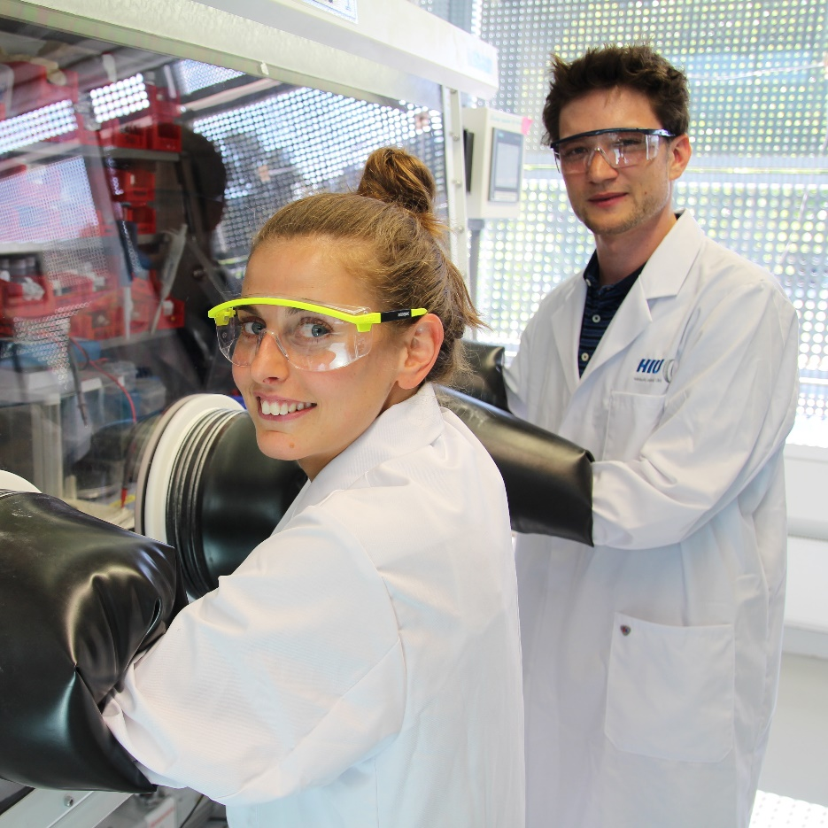

Slide 12

THANKS FOR LISTENING.

