Slide 1
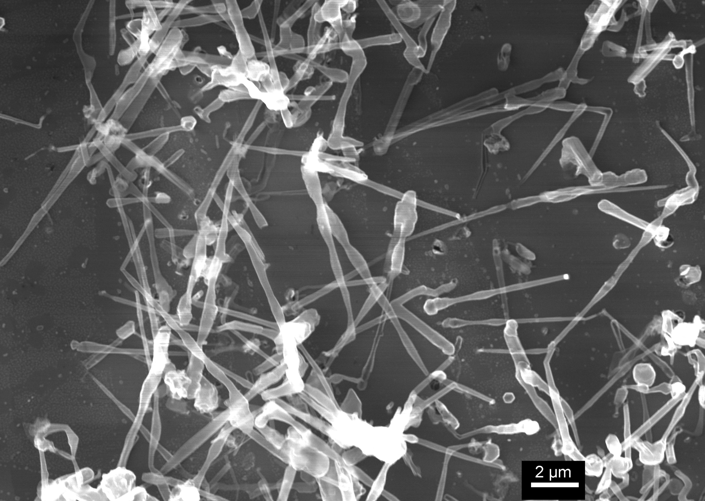
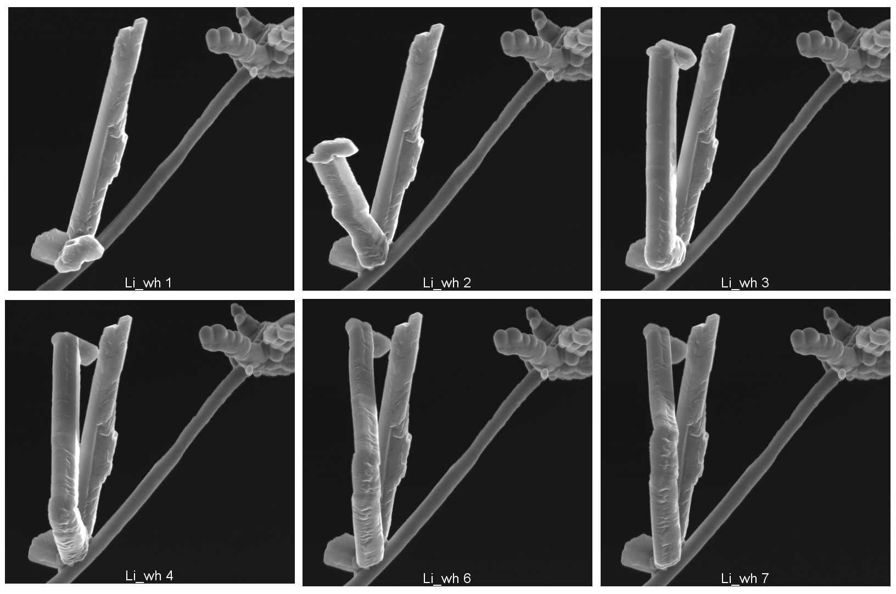
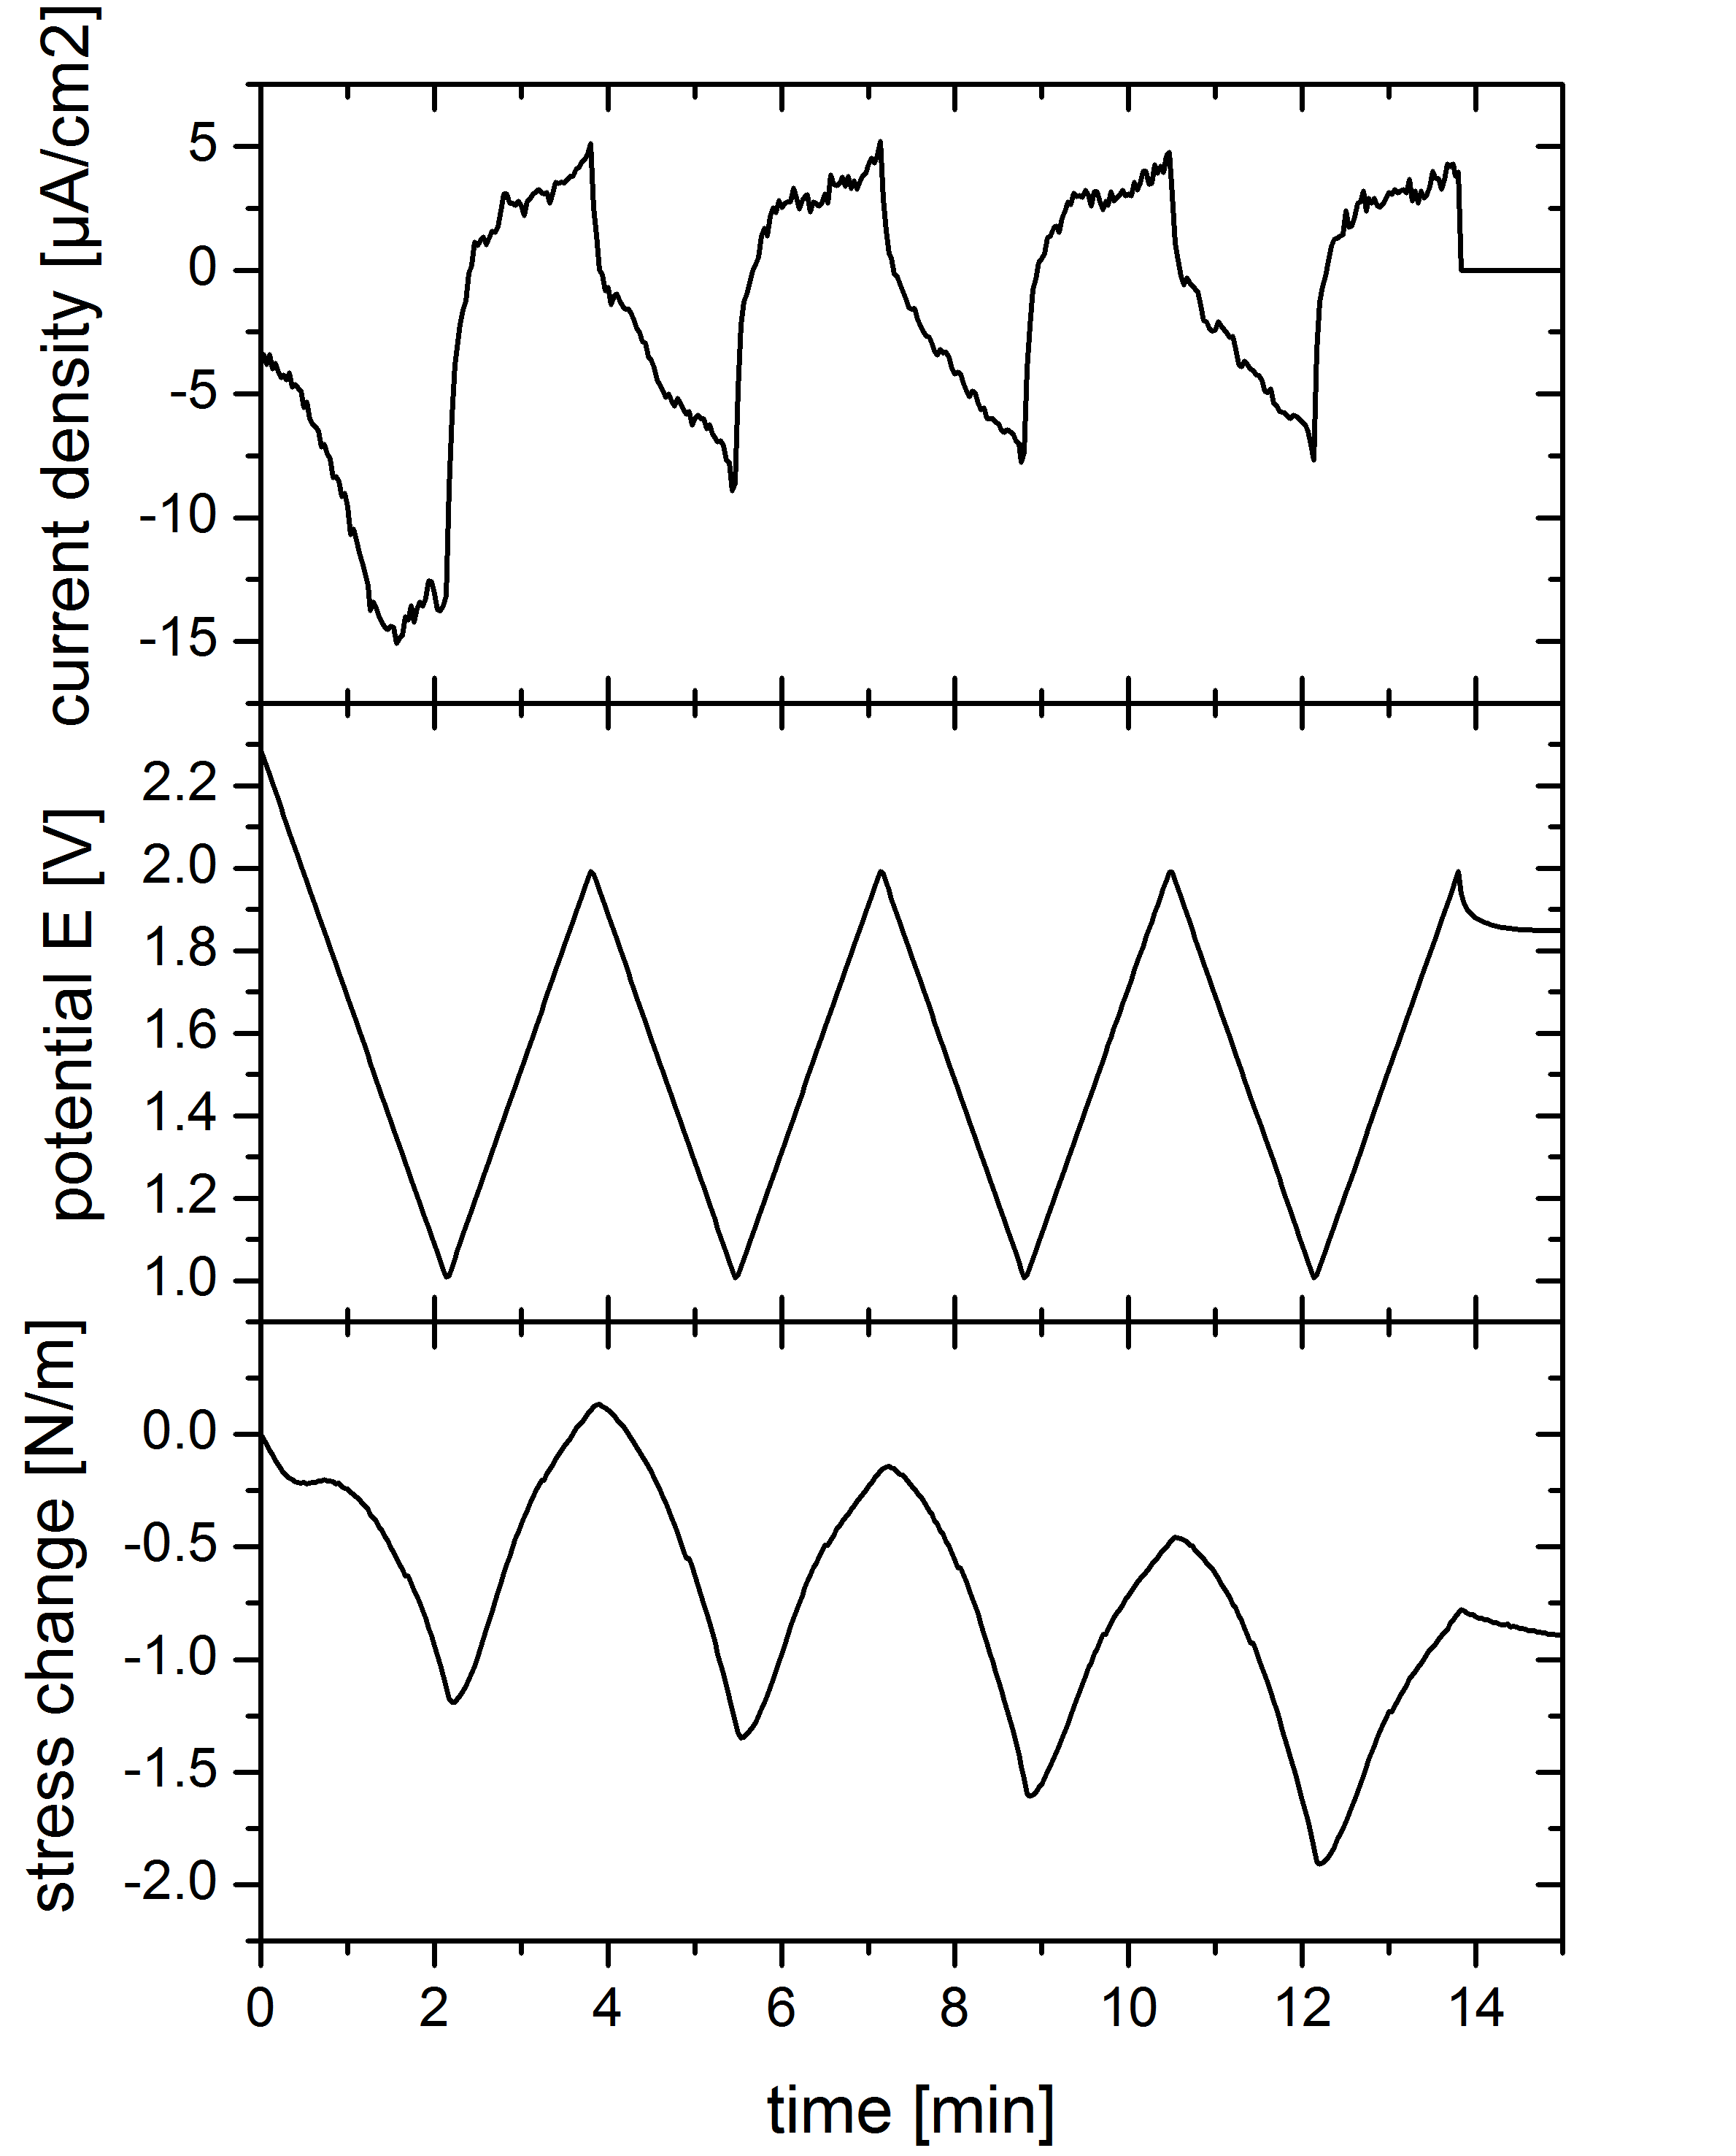
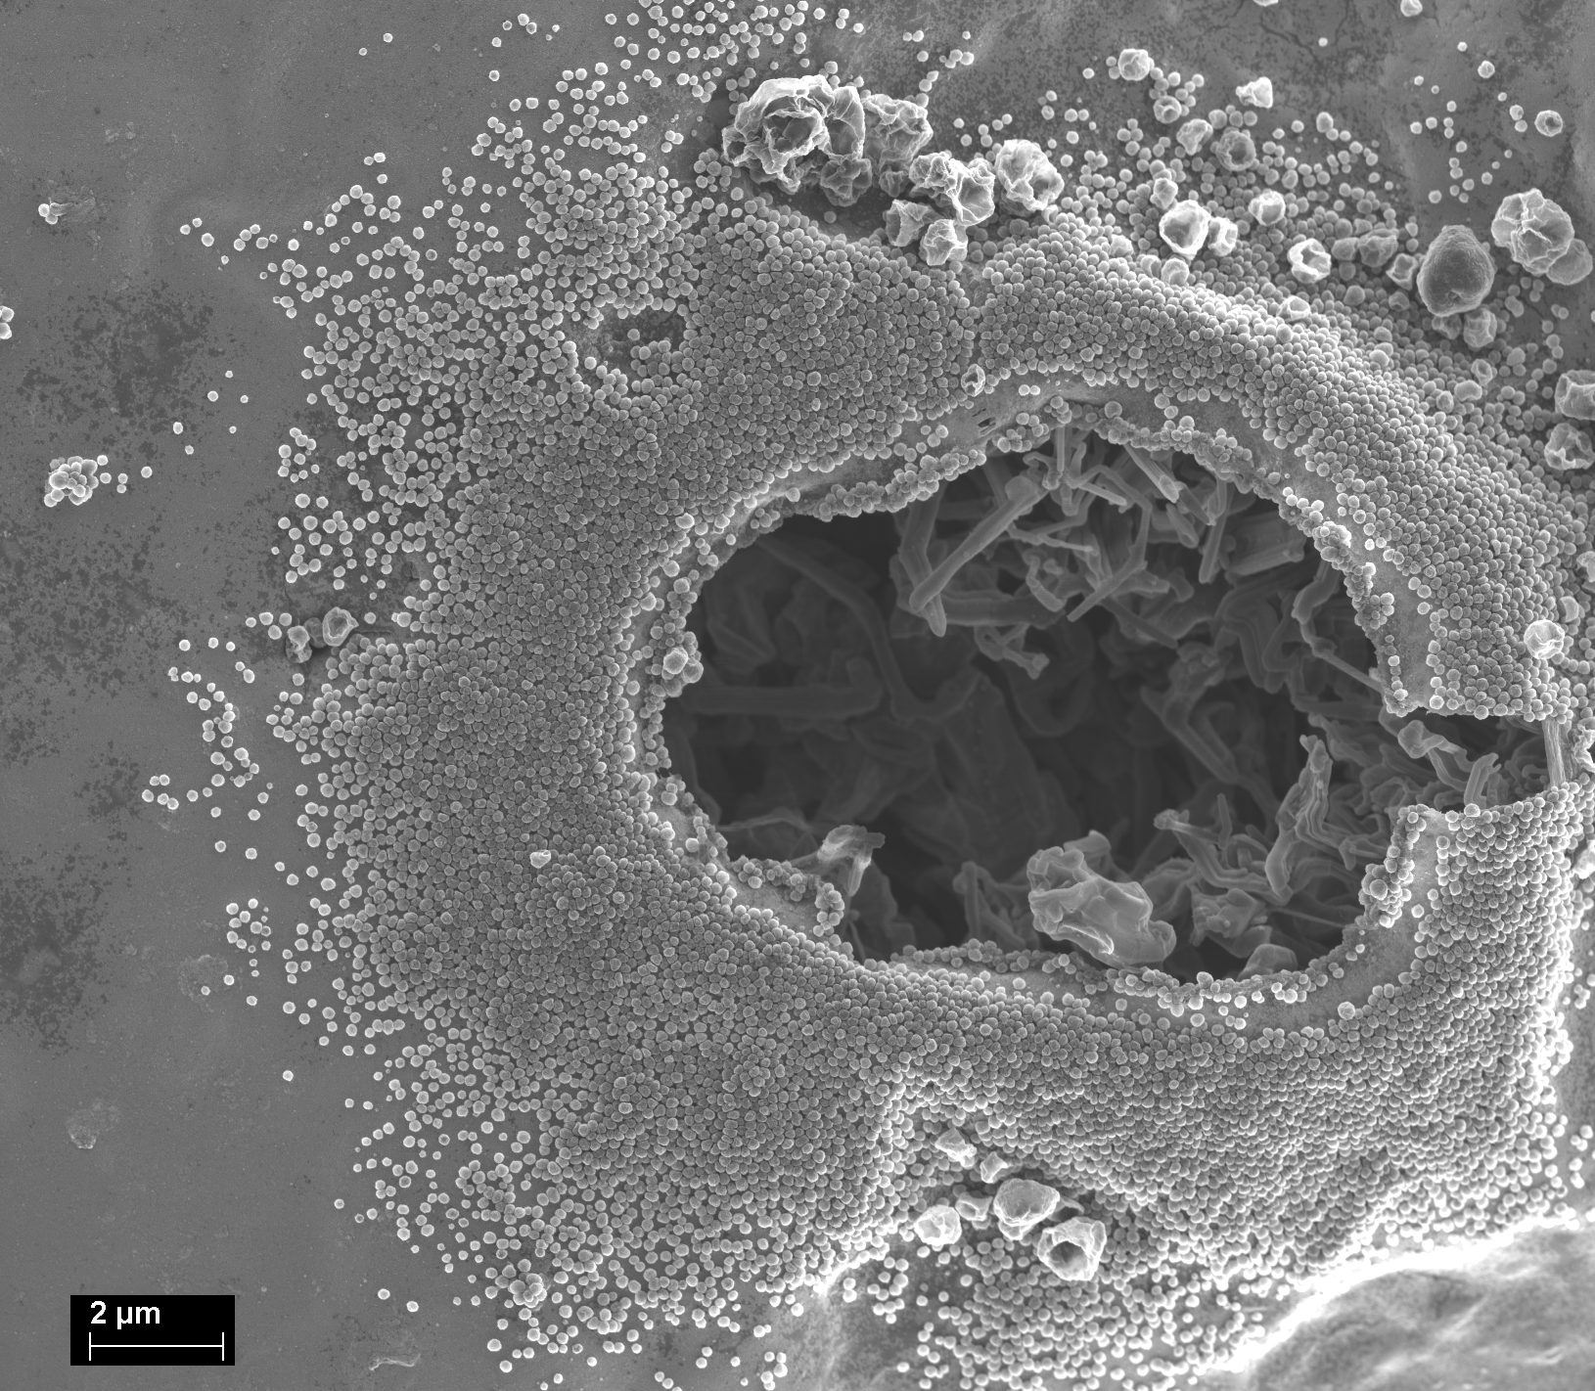
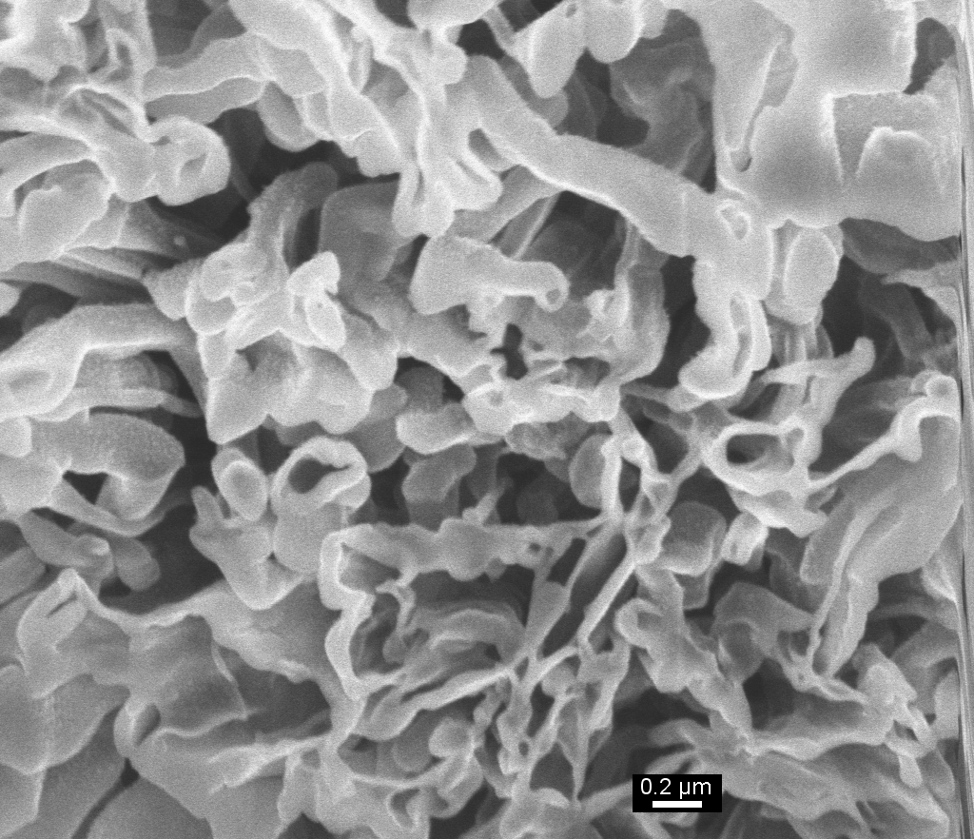
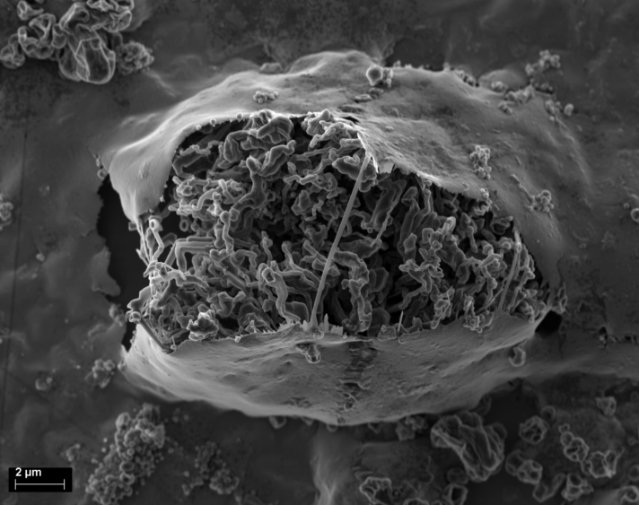
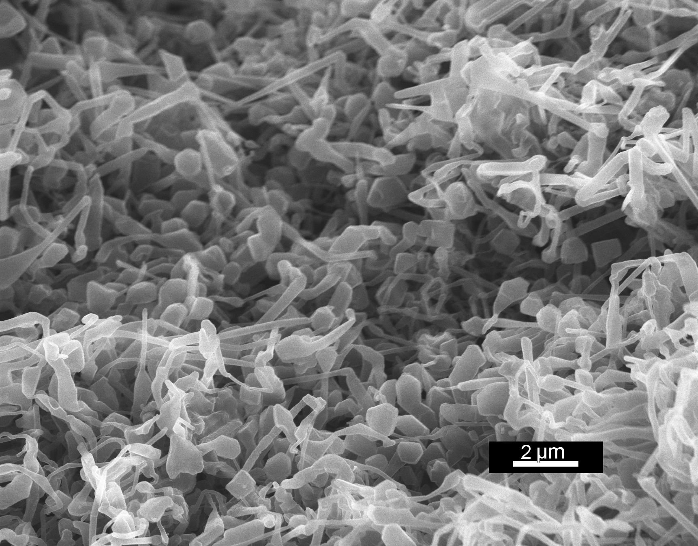
“IN SITU” AND “EX SITU” STUDIES OF LITHIUM NUCLEATION AND DENDRITIC GROWTH DURING ELECTROPLATING
Jens Steiger1, Dominik Kramer2, Steven T. Boles1, Reiner Mönig1 1 Institute for Applied Materials IAM, Karlsruhe, Germany 2 Helmholtz Institute Ulm for Electrochemical Energy Storage (HIU), Ulm, Germany
MOTIVATION AND AIM
Lithium plating can happen in all lithium ion batteries for high charging rates, especially at low temperatures
Dendritic or needle-like growth can cause short circuits: safety problem!
If controlled plating could be achieved: lithium metal anodes could be used due to their outstanding theoretical capacity: [3830, 3863] mAh/g
Aim: Understand growth modes and plating mechanism, especially mechanism of “dendritic” or needle-like growth
GROWTH OF LITHIUM WHISKERS IN VACUUM
Li whiskers are observed to grow on a silicon wire during lithiation
Clearly, the growth occurs at the base of the whisker.
This supports the view that growth might as well appear at the base during electroplating
This supports the view that growth might as well appear at the base during electroplating
SEM images of Li whiskers growing on a lithiated Si wire at room temperature
EXPERIMENTAL
microscopy: SEM Zeiss Merlin with vacuum/gas transfer system sealed glass cell for optical microscopy
stress: substrate curvature measured by laser deflection [1]
GROWTH OF LITHIUM WHISKERS IN VACUUM
Li whiskers are observed to grow on a silicon wire during lithiation
Clearly, the growth occurs at the base of the whisker.
This supports the view that growth might as well appear at the base during electroplating
„IN SITU“ STRESS MEASUREMENTS
Current, potential and stress during a CV
copper substrate 1 M LiPf₆ in EC/DMC
Considerable variantions of the stress are observed during cycling even above the metaldeposition potential
Intercalation of lithium in surface oxides
SEM images of Li whiskers growing on a lithiated Si wire at room temperature
GROWTH MODES
On copper substrates, dense lithium bushes are deposited between CU and glass. Li particles on top of CU
The fast and dense growth at sites of hindered transport demonstrates that, the transport in solution is not triggering dendritic growth.
FIB
FIB cross section
branched, dense irregular structure
no regular branching like in usual dendrites
Stochastic nucleation process?
INSERTION MECHANISM
Lithium filaments are grown between opening gaps of the copper substrate
This growth requires insertion of lithium into the growing wire, most likely at the substrate.
BUSH-LIKE LITHIUM
SEM of bush-like Li deposit
lithium is faceted -> Li is crystalline, grows in long whiskers and is frequently kinked
pointed angles and multiple kinks: growth direction not directed to the counter electrocode
SUMMARY
We suggest that Li whiskers and dendrites can grow by an insertion mechanism at defects of the SEI and of the whisker, e.g. at kinks of the whisker or at the substrate.
HIU – Joint research institute of KIT and Ulm University with associated partners DLR and ZSW │ KIT – The Research University in the Helmholtz Association

